Slide 1
Academic CV Suggestions
Abrar Hasan
Lecturer and Program Coordinator
Dept. of Software Engineering

Slide 2
1
2
Table of contents
3
<
T
0
>
Opportunity and CG Requirements and
Available University Lists
CV Suggestions
4
Interview Suggestions

Slide 3
1
CG Requirements
<
T
1
>

Slide 4

Opportunities
<
T
1
>
CSE
Software Engineering
AI and Data Science
Mechatronics engineering
Contractual Lecturers in EEE or other Departments
University Departments

Slide 5
CG Requirements
<
T
1
>
Generally CG range is 3.5 – 4.00
Preferable CG range is 3.5 – 3.75
High Paid University CG range is 3.75 – 4.00

Slide 6
2
Available University Lists
<
T
1
>

Slide 7
Available University Lists
<
T
2
>
NAME | Requirment | Remarks
UIU | Dept. Positions
AUST | Dept. Positions
UAP | 3.8+
BRAC | No idea | Good Degree/ Interanl CV Drop
East West | 3.5+
Southeast | 3.5+
BUBT | 3.75+ | Experieced Candidate
IUBAT | 3.5+
Daffodil | 3.00+
Green | 3.5+
Uttara | 3.5+
Northen | 3.5+
Prime University | 3.5+
Prime Asia | 3.5+
Sonargoan University | Exam | Drop your CV, They have goood impression on kuet
Santo Mariium | Exam | Drop your CV, They have goood impression on kuet

Slide 8
Available University Lists
<
T
2
>
NAME | Requirment | Remarks
Hamdard
World University
BGMEA University
Eastern University
Manarat University
City University

Slide 9
3
Suggestions for CV
<
T
1
>

Slide 10
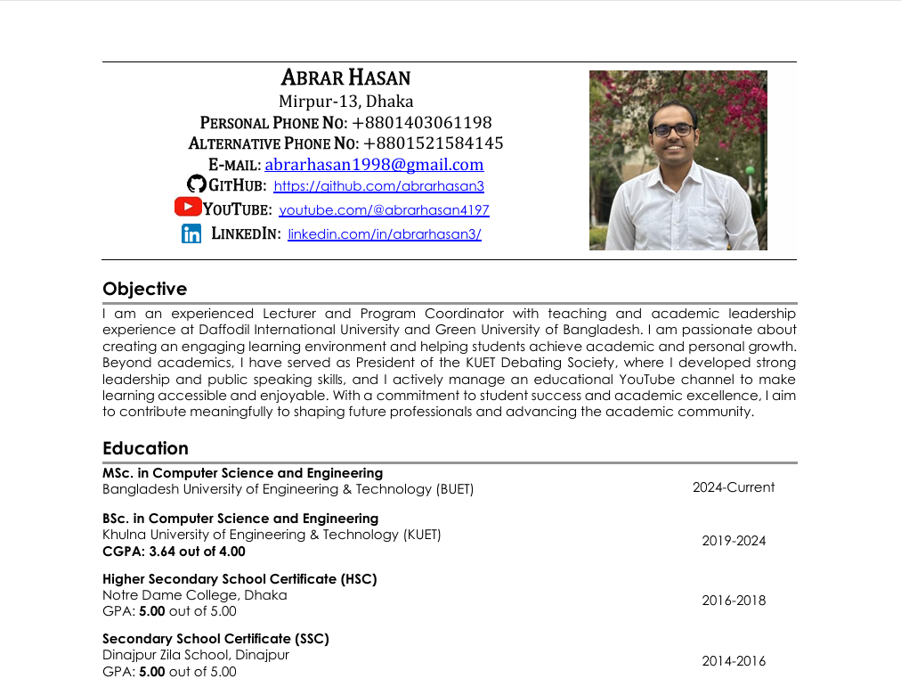
CV Suggestions
Address Must be near to the university
Mention the Links of Your GitHub/LinkedIn
Not Hyperlink
Showoff is must

Slide 11
CV Suggestions
You May Add a professional Picture
Write Objective with ChatGPT
Education Section is in the first Page
Mention and Bold Your CG
And Add All education

Slide 12
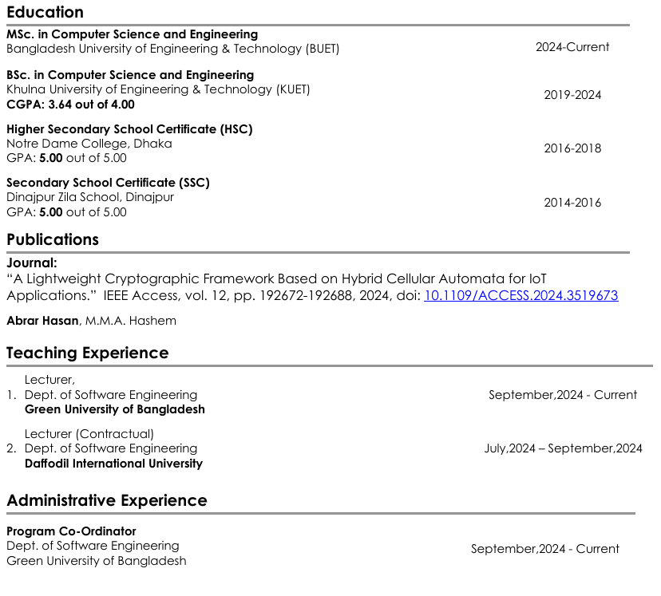
CV Suggestions
Mention Publication.
Bold Your name and DOI Link
Mention Teaching Experience if any
Mention Administrative Experience

Slide 13
CV Suggestions
Mention Publication.
Bold Your name and DOI Link
Mention Teaching Experience if any
Mention Administrative Experience

Slide 14

CV Suggestions
If the paper has not yet been published then write like this

Slide 15
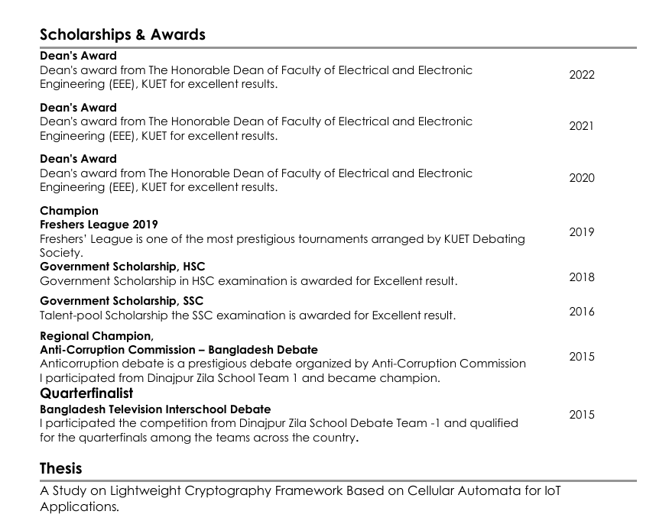
CV Suggestions
Mention All awards. Make your CV rich
Mention Your thesis

Slide 16
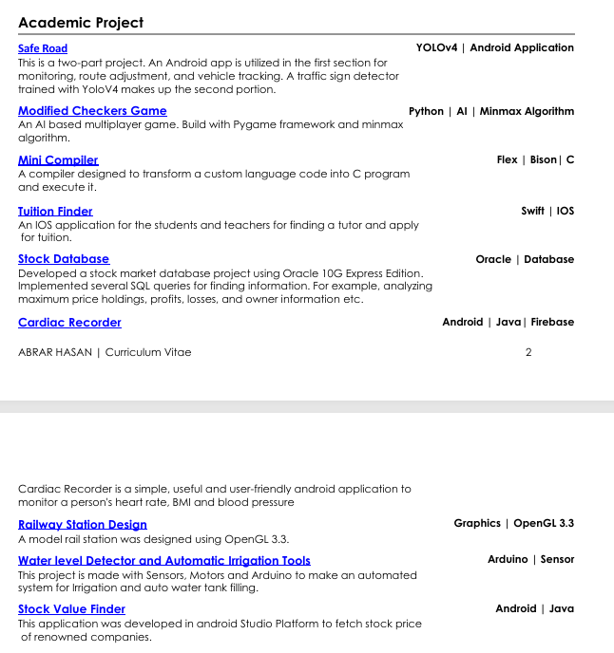
CV Suggestions
Mention Academic Projects and some Descriptions.

Slide 17
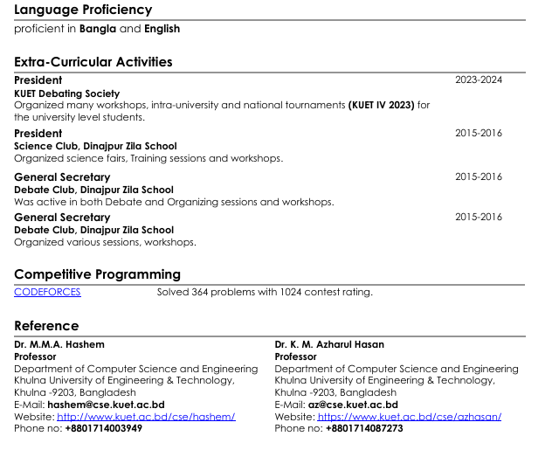
CV Suggestions
Always Write your are Excellent in Bangla and English
Add Good Extra Curricular Activities
Mention CP Profile. If CP profile is good, mention it in the first page
Reference

Slide 18
Thank You

